Slide 1


Minimum Warehouse and Transportation Cost
December 1, 2025
Mathematical and Statistical Sciences
Yawen Huang
https://www.boxful.com.tw/blog/倉儲/

Slide 2
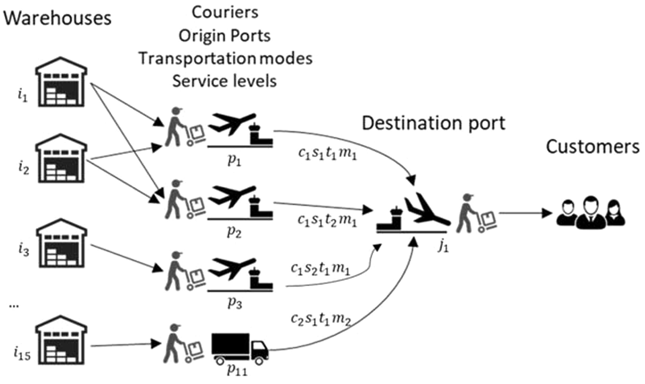
1. Introduction
Microchip producer
9216 Orders
15 Warehouses, 11 Origin Ports
One Destination Port
9 Couriers, offering different rates for different weight bands.
Mixed Integer Linear Programming (MILP) Models
w₁
w₂
w₃
w₁₅
https://www.sciencedirect.com/science/article/pii/S0360835220303442?via%3Dihub#f0010
https://brunel.figshare.com/articles/dataset/Supply_Chain_Logistics_Problem_Dataset/7558679?file=20162015

Slide 3
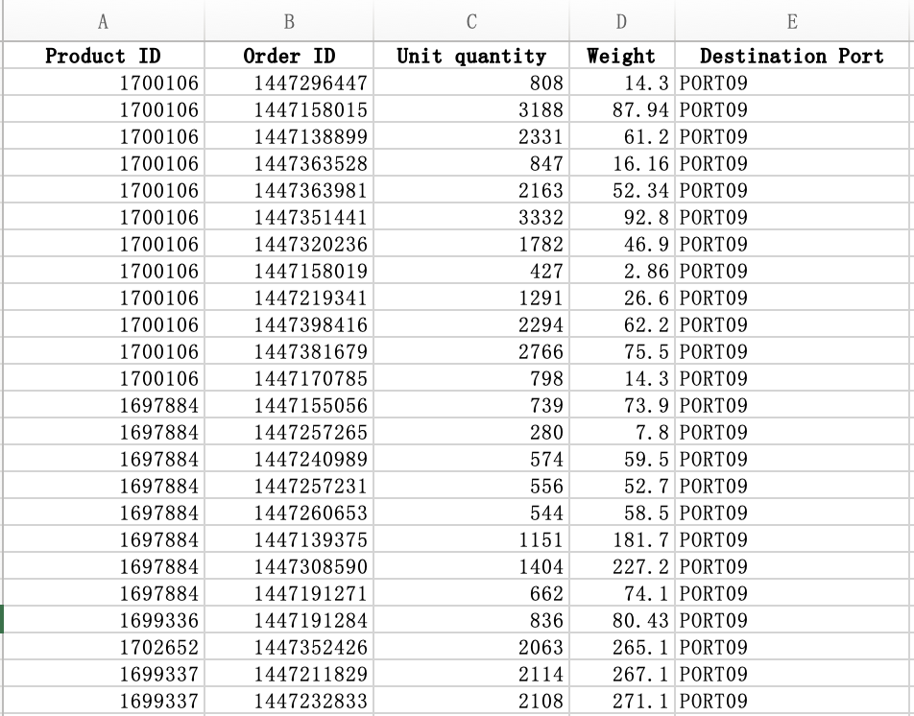
2. Data and Business Context
OrderList
Order ID
Product ID
Unit Quantity
Weight
Destination Port
We have 9216 orders, each Order has a uniq Order ID, and we have the weight, Unit Quantity and Destination Port of each order. The Product ID can be linked to the ProductsPerPlant table to determine the corresponding warehouse and origin port for that order.

Slide 4
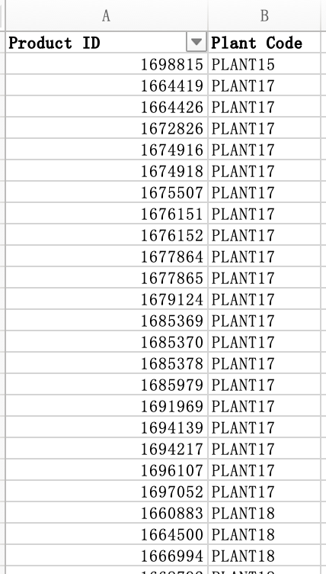
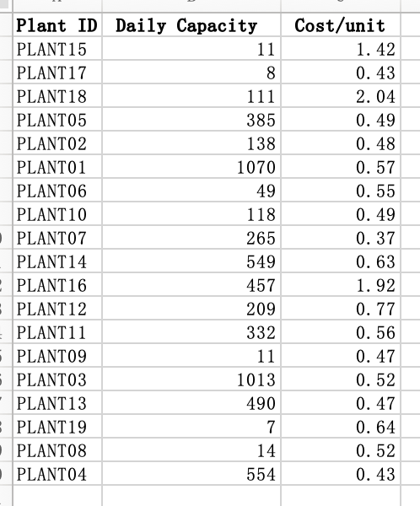
ProductsPerPlant PLANT Capacity and cost
Daily capacity refers to the number of orders the warehouse can process in a single day.
Each product has its designated warehouse.

Slide 5
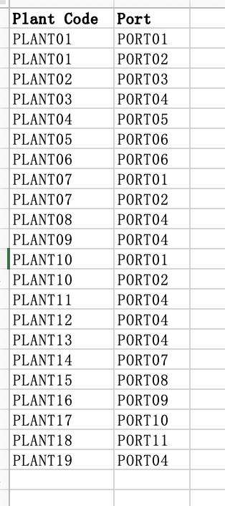
PlantPorts
Each warehouse has its specific Origin ports.

Slide 6
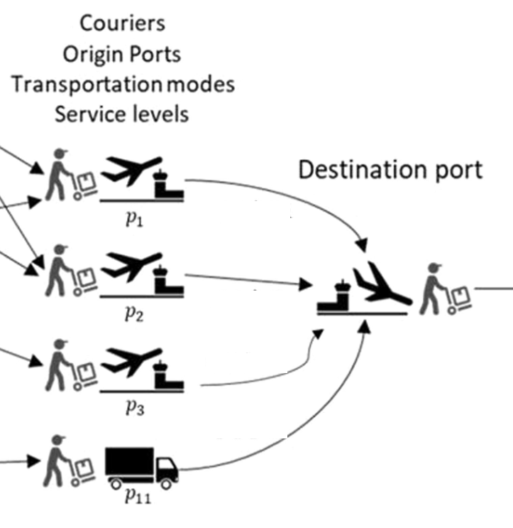
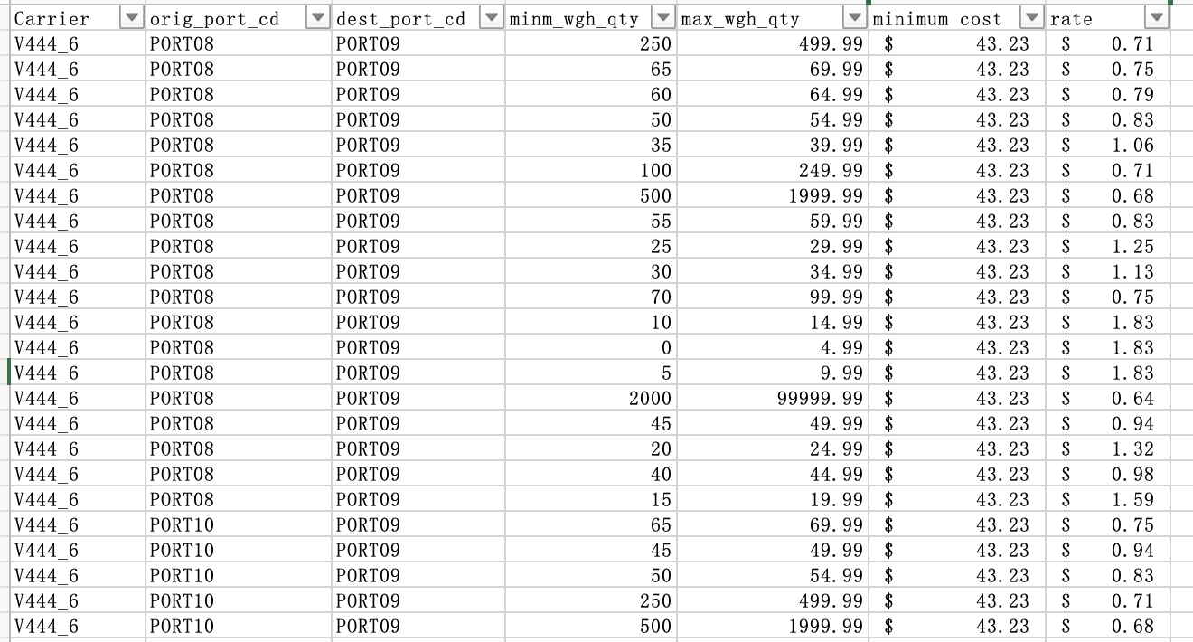
FreightRates
9 carriers offering different rates for different weight bands.

Slide 7
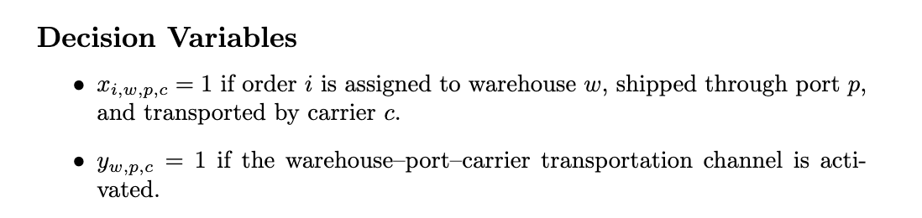
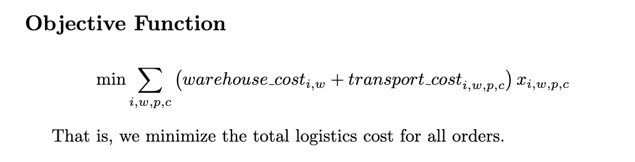
LP Model Formulation
We define binary variables x to choose how each order is shipped through which warehouse w, port p, and carrier c. and binary variable y to indicate whether a transportation channel is activated.
(Binary decision variables)
Our objective function is to minimize the total logistics cost. For each feasible route, warehouse, port, and carrier, we add together the warehouse cost and the transportation cost, and multiply that by the decision variable x_{i,w,p,c}. The model then chooses the combination of routes that has the lowest cost.

Slide 8
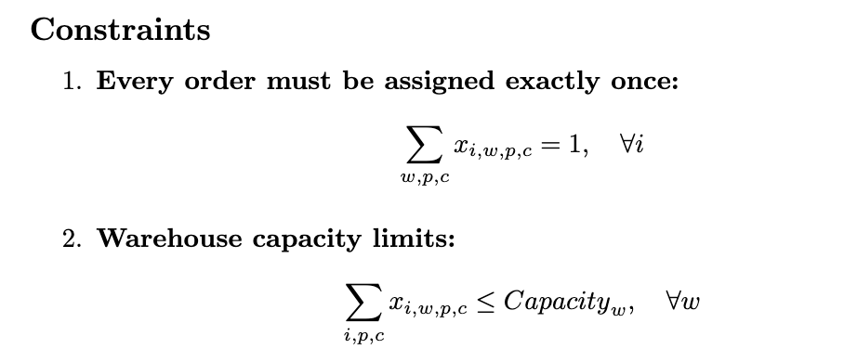
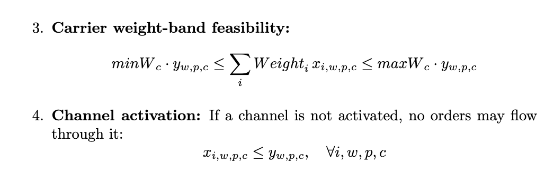
Four constraints:
First, each order must be assigned exactly once, meaning it must choose one valid combination of warehouse, port, and carrier.
Second, each warehouse has a daily processing capacity, so the total number of assigned orders cannot exceed its limit.
Third, each carrier has a feasible weight band. The total shipment weight assigned to a carrier must fall between its lower bound and upper bound.
Fourth, we use channel activation constraints. If a warehouse–port–carrier channel is not activated, no order is allowed to flow through it. This ensures the model uses only valid and consistent transportation routes.

Slide 9
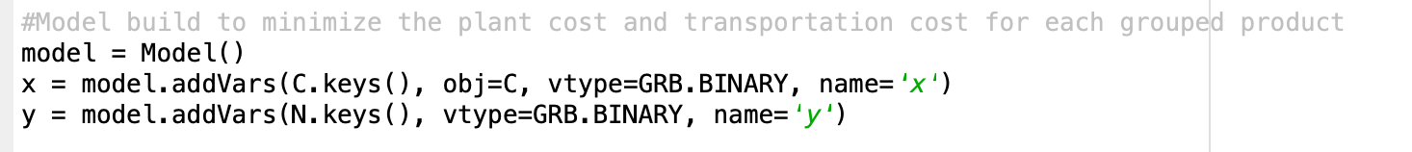
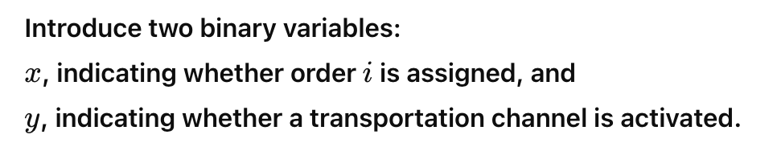
Definition of decision variables: Model build to minimize the plant cost and transportation cost for each grouped product
Implementation Code
(Use Python Gurobi solver to solve this problem)

Slide 10
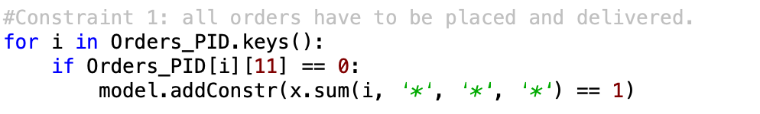
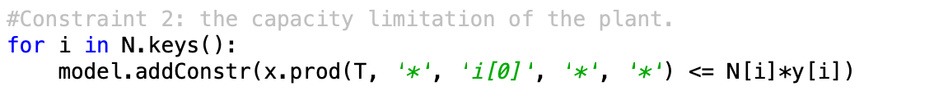
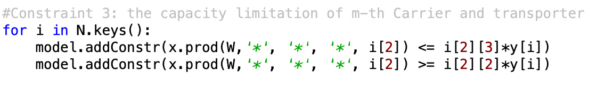
Constraint 1: all orders have to be assigned.
Constraint 2: the capacity limitation of the plant.
Constraint 3: the capacity limitation of m-th Carrier and transporter

Slide 11
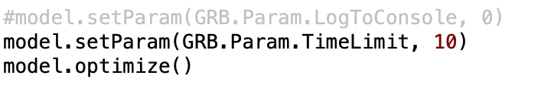
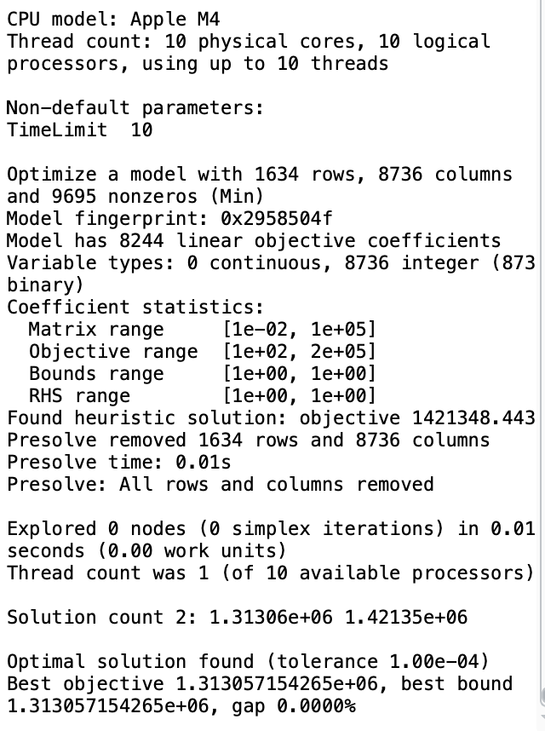
Run the model and results

Slide 12
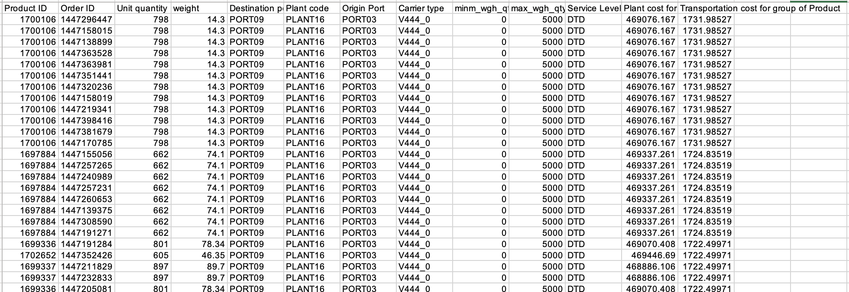
Optimal Solutions

Slide 13
THANK YOU!

